Slide 1
Plebiscites as a Tool for Resolving Territorial Conflicts after the First World War and its Use by Hungary as an Argument during the Peace Negotiations
László Komáromi
Pázmány Péter Catholic University
Faculty of Law and Political Sciences
100 YEARS OF TREATY OF TRIANON –
DIPLOMACY, STATE AND LAW ON THE TURN OF THE CENTURY
14-15 October 2021

Slide 2
1. The Principle of Self-Determination (01)
President Woodrow Wilson:
“[...] No peace can last, or ought to last, which does not recognize and accept the principle that governments derive all their just powers from the consent of the governed, and that no right anywhere exists to hand peoples about from sovereignty to sovereignty as if they were property. […] No nation should seek to extend its polity over any other nation or people, but that every people should be left free to determine its own polity, its own way of development, unhindered, unthreatened, unafraid, the little along with the great and powerful. [...]” (Address to the Senate on 22 January 1917)

Slide 3
1. The Principle of Self-Determination (02)
Ambiguities – What does it mean?
“Self-determination”: independence or autonomy?
“People”: state, nation or a part of the nation?
Who is entitled to decide on questions of self-determination?
→ plebiscite?

Slide 4
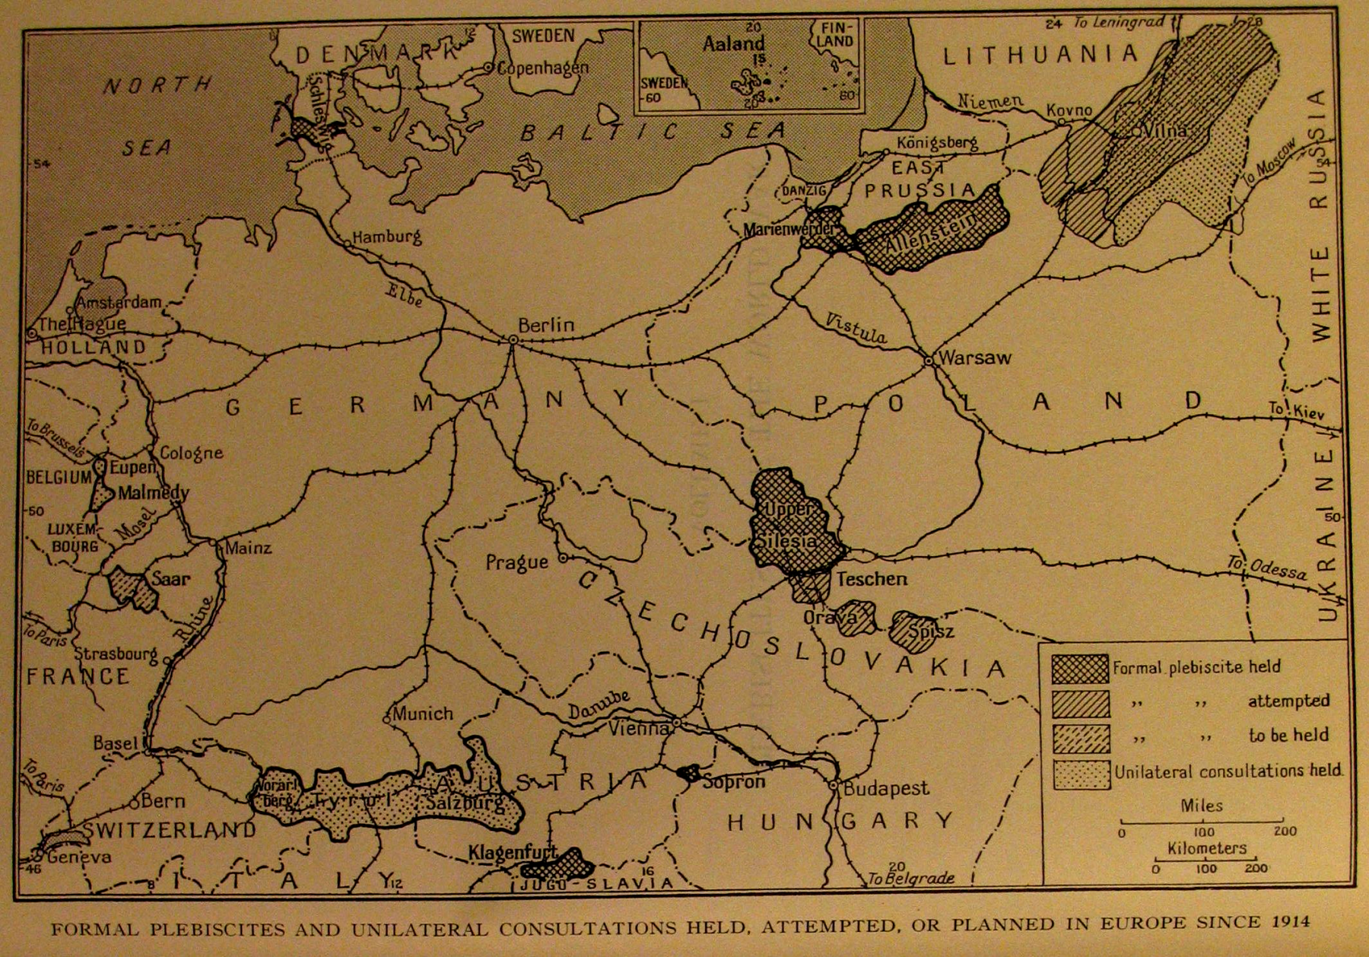
2. Plebiscites held after World War I on the border of Germany and Austria (01)
Source: Sarah Wambaugh: Plebiscites Since the World War. Washington, 1933. p. 2.

Slide 5
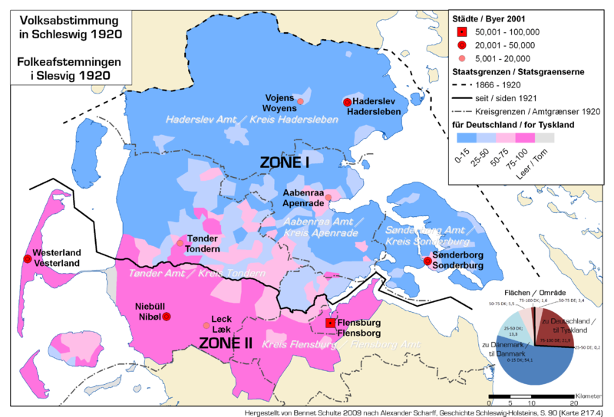
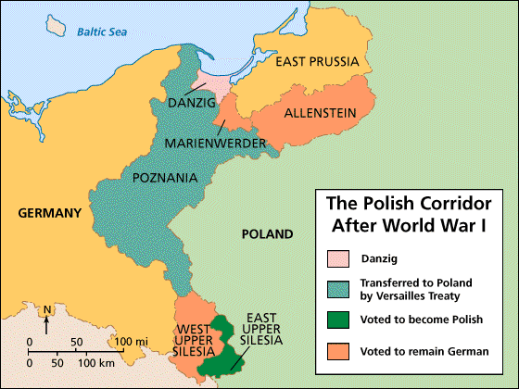
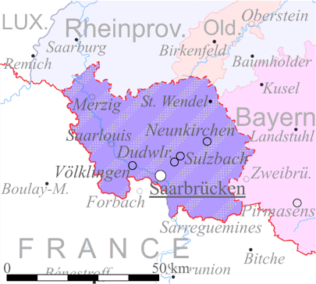
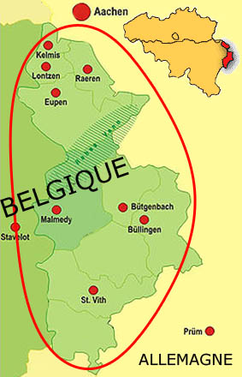
2. Plebiscites held after World War I – Germany (02)
The Schleswig Plebiscites (February-March 1920)
Source: http://en.wikipedia.org/wiki/File:Abstimmung-schleswig-1920.png
Plebiscites in Allenstein, Marienwerder (July 1920)
and in Upper Silesia (March 1921)
Source: http://go.hrw.com/hrw.nd/gohrw_rls1/pKeywordResults?keyword=st9%20polish%20wwi
Eupen and Malmédy: unilateral consultations (January-July 1920)
Source: http://reflexions.ulg.ac.be/cms/c_37111/fr/les-enroles-de-force-de-1940-1945-malgre-eux
The Saar Plebiscite (1935)
Source: http://upload.wikimedia.org/wikipedia/commons/d/d2/Saarbeckengebiet_map.gif

Slide 6
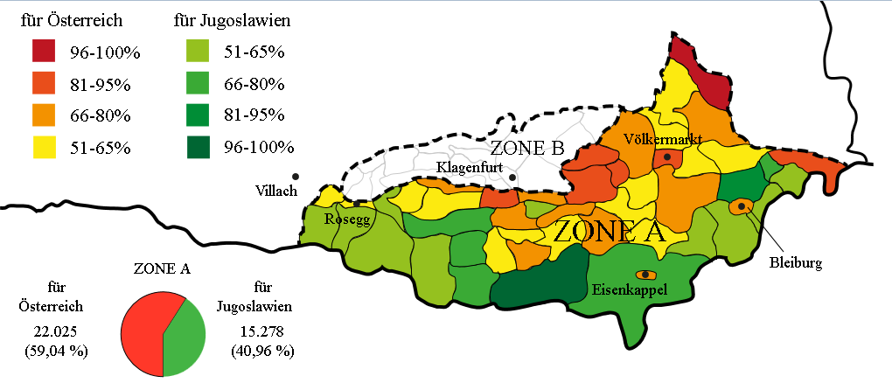
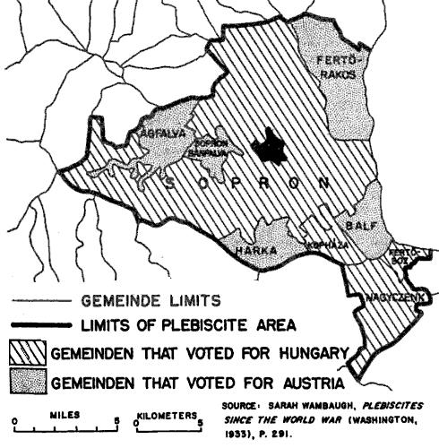
2. Plebiscites held after World War I – Austria (03)
Carinthian plebiscite (October 1920)
Source: http://en.wikipedia.org/wiki/File:Volkabstimmung_K%C3%A4rnten_1920.svg
Sopron Plebiscite (December 1921)
Not foreseen by the Treaty of Saint-Germain!
Source: http://www.the-burgenland-bunch.org/Newsletter/Newsletter210.htm
Other proposed/demanded plebiscites, e.g.:
Alsace-Lorraine
All German-speaking territories of Austria, etc.
Allied Powers: only exceptionally, mostly in order to escape from a dilemma

Slide 7
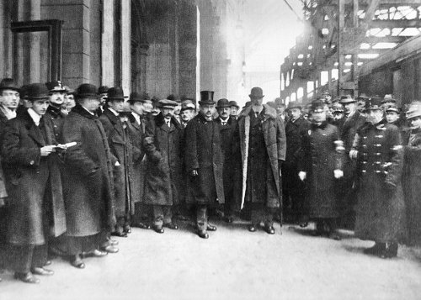
3. The argumentation of Hungary (01)
Preparatory notes for the peace negotiations:
Insistence on the integrity of Hungary’s historic territory
Historic arguments
Economic arguments
but
readiness to hold territorial plebiscites
Only general references
Without detailed proposals
The Hungarian Peace Delegation with Albert Apponyi
on 5 January 1920 at Keleti Railway Station in Budapest
Source: http://tortenelemportal.hu/2010/06/apponyi-albert-parizsban/

Slide 8
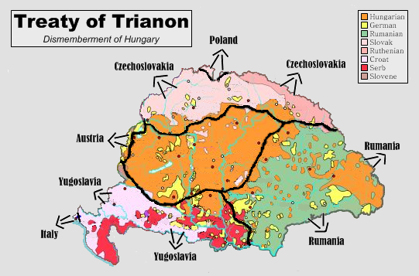
3. The argumentation of Hungary (02)
After having received the terms of peace (15 January 1920):
Still insisting on historic borders
but
with a more emphasized claim for plebiscites:
Apponyi’s speech on 16 January:
„we demand a plebiscite on those parts of Hungary that are now on the point of being severed from us”
Official reply to the peace conditions on 12 February:
Detailed articles on how plebiscites should be organised
Source: http://www.dvhh.org/history/1900s/Trianon-index.htm
Terms of peace: disannexation of
about two-thirds of Hungarian territory
3.2 million ethnic Hungarians

Slide 9
4. The reply of the Allied Powers (6 May 1920)
Hungarian claims were rejected:
"any modification of the frontiers fixed by them would lead to inconveniences graver than those proclaimed by the Hungarian Delegation"
"a popular vote […] would not offer a result differing sensibly from those which they [the Allied Powers] have arrived at after a minute study of the ethnographic conditions of Central Europe and of national aspirations"
"The will of the people was expressed in the October and November of 1918 at the collapse of the Dual Monarchy when the populations, oppressed for so long, united with their Italian, Roumanian, Yougo-Slav and Czecho-Slovak kindred."

Slide 10
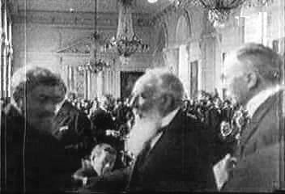
5. To what extent were Hungarian tactics appropriate?
Persistence on Hungary’s territorial integrity: a hopeless matter
An example of the opposite: Austria:
The disintegration of the Habsburg Empire was accepted from the beginning
But plebiscites in all German-speaking territories were requested
→ a limited success: plebiscite in Carinthia; annexation of Burgenland
Hungarian detailed request for plebiscites was late
Even a partial acceptance of the preliminary terms of peace was practically impossible because of domestic politics
Signing the Peace Treaty of Trianon
in Versailles, 4 June 1920
Source: http://en.wikipedia.org/wiki/File:Treaty_of_trianon_negotiations.jpg

